Slide 1

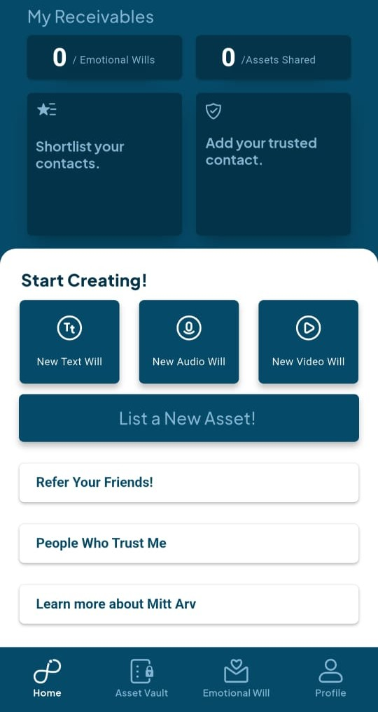
Mitt Arv App - Overview
What it is: A secure digital platform to store all your assets (bank accounts, property, insurance) and last messages (text, voice, video) for loved ones.
Key Functioning: Organizes and encrypts personal data, allows adding trusted contacts, and enables controlled sharing after passing.
Purpose: To give peace of mind, reduce confusion for families, and ensure assets and last wishes are safely passed on.

Slide 2
Strengths & Gaps
Strengths
Gaps
Clean UI and easy to use for all age groups
Updates reflect instantly across devices
Strong encryption ensures privacy
Hard to track who edited what
No notifications(users miss updates or changes)
Storage space is too limited for free-tier accounts.

Slide 3
Family Plan Proposal
Roles: Current roles are Owner and Members; add a Family/Personal Lawyer role to provide legal support and guidance.
Price: Currently, pricing changes only with storage. You could improve it by adding region-based pricing, group-size-based pricing, and other scalable factors to create a fair and flexible model.
Wealth Goals: Consider adding a feature to set personal or family wealth goals, helping users improve savings habits and track financial growth.
Insurance Solutions: Implement insurance solutions for health, auto, and wills to provide robust financial protection for those striving to make ends meet.

Slide 4
Expected Impact
Roles: Adding a Family/Personal Lawyer role will enhance trust and credibility, providing users with reliable legal guidance and support, improving overall user satisfaction and engagement.
Price: Introducing region- and group-size-based pricing makes the model fairer and more scalable, improving adoption, retention, and revenue potential.
Wealth Goals: Allowing users to set personal or family wealth targets encourages disciplined savings, financial growth, and sustained engagement.
Insurance Solutions: Providing insurance options for health, auto, and wills delivers meaningful financial protection for users managing tight budgets, enhancing platform value and loyalty.

